Slide 1
Chapter 15 Files, Input/Output Streams, NIO and XML Serialization

Slide 2
Objectives
In this chapter you’ll:
Create, read, write and update files.
Retrieve information about files and directories using features of the NIO.2 APIs.
Learn the differences between text files and binary files.
Use class Formatter to output text to a file.
Use class Scanner to input text from a file.
Use sequential file processing to develop a real-world credit-inquiry program.
Write objects to and read objects from a file using XML serialization and the JAXB (Java Architecture for XML Binding) APIs.
Use a JFileChooser dialog to allow users to select files or directories on disk.
Optionally use java.io interfaces and classes to perform bytebased and character-based input and output.

Slide 3
15.1 Introduction
Data stored in variables and arrays is temporary
It’s lost when a local variable goes out of scope or when the program terminates
For long-term retention of data, computers use files.
Computers store files on secondary storage devices
hard disks, optical disks, flash drives and magnetic tapes.
Data maintained in files is persistent data because it exists beyond the duration of program execution.

Slide 4
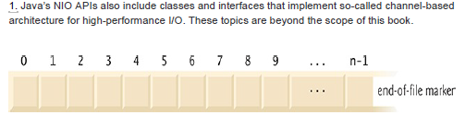
15.2 Files and Streams
Java views each file as a sequential stream of bytes
fig. 15.1 Java’s view of a file of n bytes.
Every operating system provides a mechanism to determine the end of a file, such as an end-of-file marker or a count of the total bytes in the file that is recorded in a system-maintained administrative data structure.

Slide 5
15.2 Files and Streams (cont.)
File streams can be used to input and output data as bytes or characters.
binary files
byte-based streams
Streams that input and output bytes
text files
character-based streams
Streams that input and output characters

Slide 6
15.2 Files and Streams (cont.)
A Java program opens a file by creating an object and associating a stream of bytes or characters with it.
Can also associate streams with different devices.
Java creates three stream objects when a program begins executing
System.in
System.out
System.err
Class System provides methods setIn, setOut and setErr to redirect the standard input, output and error streams, respectively.

Slide 7
15.2 Files and Streams (cont.)
Java programs perform stream-based processing with
classes and interfaces from package java.io and the subpackages of java.nio.

Slide 8
15.3 Using NIO Classes and Interfaces to Get File and Directory Information
Interfaces Path and DirectoryStream and classes Paths and Files (all from package java.nio.file):
Path interface—Objects of classes that implement Path represent the location of a file or directory.
Paths class—Provides static methods used to get a Path object representing a file or directory location.
Files class—Provides static methods for common file and directory manipulations
DirectoryStream interface—Objects of classes that implement this interface enable a program to iterate through the contents of a directory.

Slide 9
15.3 Using NIO Classes and Interfaces to Get File and Directory Information (cont.)
Creating Path Objects
Path path = Paths.get("C:/", "Xmp");
Path path2 = Paths.get("C:/Xmp");
URI u = URI.create("file://C:/Xmp/dd.txt"); //on Windows
Path p = Paths.get(u);
URI u = URI.create("file:/home/dd.txt"); //on Mac

Slide 10
15.3 Using NIO Classes and Interfaces to Get File and Directory Information (cont.)
Example: getting file and directory information
import java.io.IOException;
import java.nio.file.DirectoryStream;
import java.nio.file.Files;
import java.nio.file.Path;
import java.nio.file.Paths;
import java.util.Scanner;
public class FileAndDirectoryInfo
{
public static void main(String[] args) throws IOException
{
Scanner input = new Scanner(System.in);
System.out.println("Enter file or directory name:");
// create Path object based on user input
Path path = Paths.get(input.nextLine());

Slide 11
if (Files.exists(path)) // if path exists, output info about it
{
// display file (or directory) information
System.out.printf("%n%s exists%n", path.getFileName());
System.out.printf("%s a directory%n", Files.isDirectory(path) ? "Is" : "Is not");
System.out.printf("%s an absolute path%n", path.isAbsolute() ? "Is" : "Is not");
System.out.printf("Last modified: %s%n", Files.getLastModifiedTime(path));
System.out.printf("Size: %s%n", Files.size(path));
System.out.printf("Path: %s%n", path);
System.out.printf("Absolute path: %s%n", path.toAbsolutePath());
if (Files.isDirectory(path)) // output directory listing
{
System.out.printf("%nDirectory contents:%n");
// object for iterating through a directory's contents
DirectoryStream<Path> directoryStream = Files.newDirectoryStream(path);
for (Path p : directoryStream)
System.out.println(p);
}
}
else // not file or directory, output error message
{
System.out.printf("%s does not exist%n", path);
}
}
} // end class FileAndDirectoryInfo

Slide 12
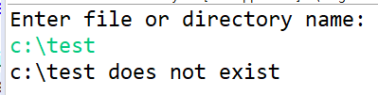
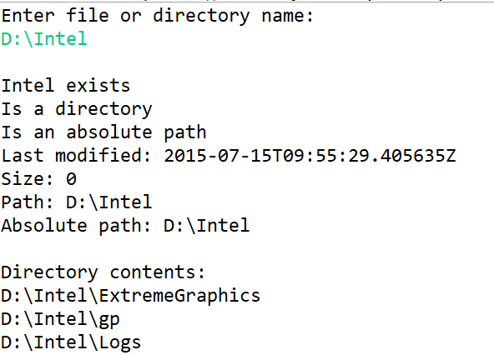

Slide 13
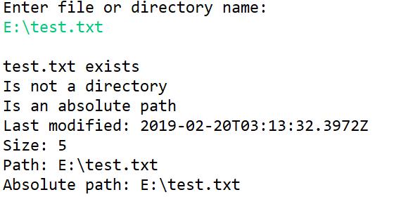

Slide 14
15.3 Using NIO Classes and Interfaces to Get File and Directory Information (cont.)
Separator Characters
On a Windows computer, the separator character is a backslash (\). On a Linux or macOS system, it’s a forward slash (/).
Java processes both characters identically in a pathname.
For example, if we were to use the path c:\Program Files\Java\jdk1.6.0_11\demo/jfc Java would still process the path properly.

Slide 15
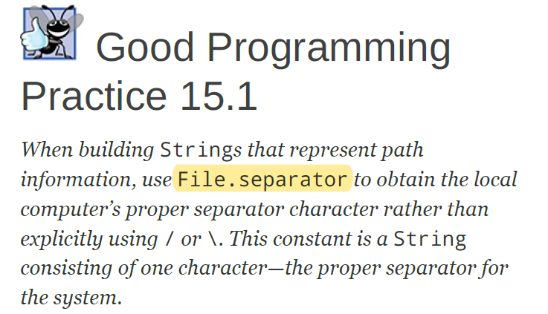

Slide 16
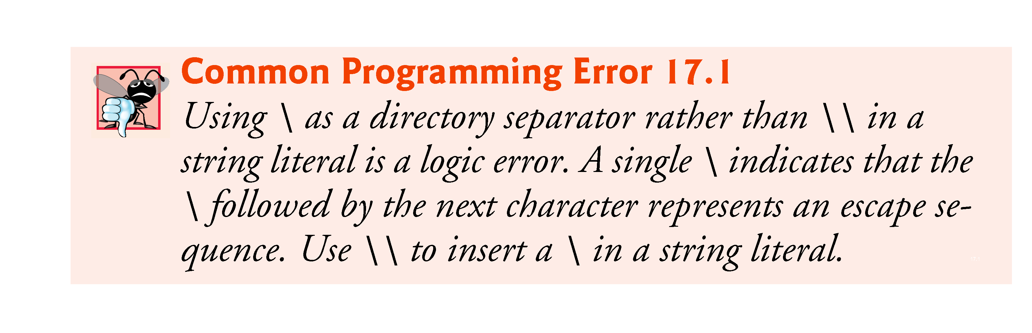

Slide 17
15.4 Sequential Text Files
Sequential-access files store records in order by the record-key field.
Text files are human-readable files.

Slide 18
15.4.1 Creating a Sequential-Access Text File
Java imposes no structure on a file
Notions such as records do not exist as part of the Java language.
You must structure files to meet the requirements of your applications.

Slide 19
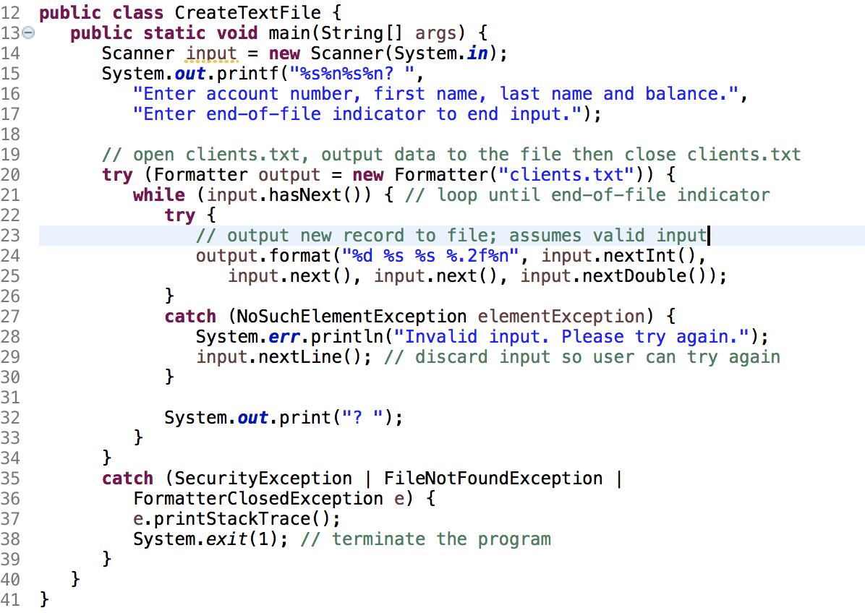

Slide 20
15.4.1 Creating a Sequential-Access Text File (cont.)
Formatter outputs formatted Strings to the specified stream.
The constructor with one String argument receives the name of the file, including its path.
If a path is not specified, the JVM assumes that the file is in the directory from which the program was executed.
If the file does not exist, it will be created.
If an existing file is opened, its contents are truncated.

Slide 21
15.4.1 Creating a Sequential-Access Text File (cont.)
A SecurityException occurs if the user does not have permission to write data to the file.
A FileNotFoundException occurs if the file does not exist and a new file cannot be created.
the FormatterClosedException that occurs if the Formatter object is closed when you attempt to use it to write into a file.

Slide 22
15.4.1 Creating a Sequential-Access Text File (cont.)
Scanner method hasNext determines whether the end-of-file key combination has been entered.
A NoSuchElementException occurs if the data being read by a Scanner method is in the wrong format or if there is no more data to input.
Formatter method format works like System.out.printf
A FormatterClosedException occurs if the Formatter is closed when you attempt to output.
Formatter method close closes the file.
If method close is not called explicitly, the operating system normally will close the file when program execution terminates.

Slide 23
15.4.1 Creating a Sequential-Access Text File (cont.)
static method System.exit terminates an application.
An argument of 0 indicates successful program termination.
A nonzero value, normally indicates that an error has occurred.
The argument is useful if the program is executed from a batch file on Windows or a shell script on UNIX/Linux/Mac OS X.

Slide 24
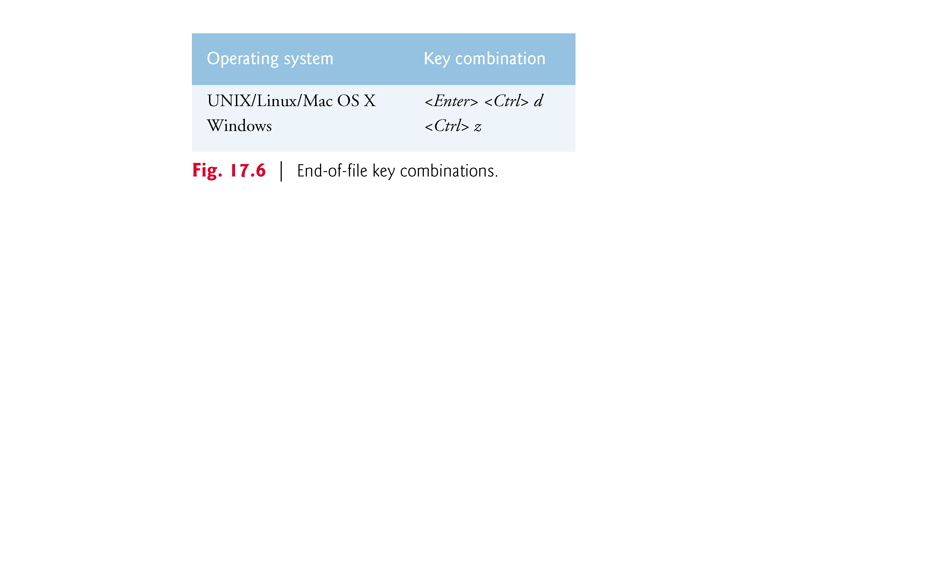

Slide 25
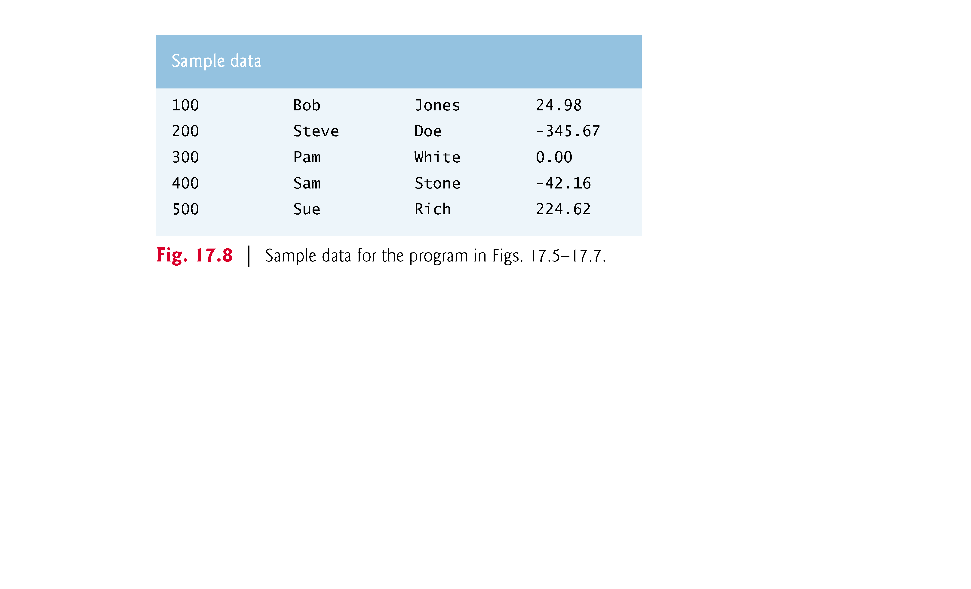

Slide 26
15.4.2 Reading Data from a Sequential-Access Text File
If a Scanner is closed before data is input, an IllegalStateException occurs.

Slide 27
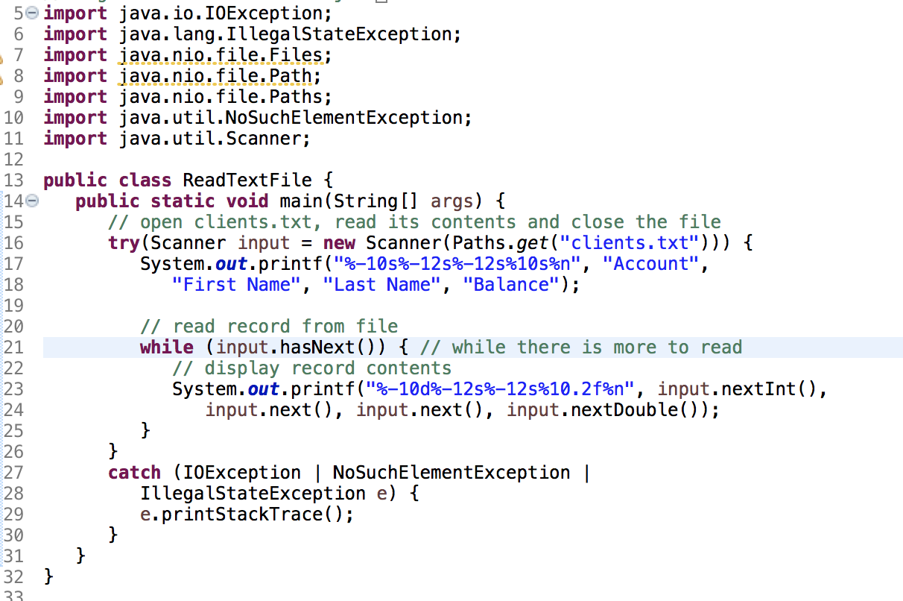

Slide 28
15.4.3 Case Study: A Credit-Inquiry Program
To retrieve data sequentially from a file, programs start from the beginning of the file and read all the data consecutively until the desired information is found.
It might be necessary to process the file sequentially several times (from the beginning of the file) during the execution of a program.
Class Scanner does not allow repositioning to the beginning of the file.
The program must close the file and reopen it.

Slide 29
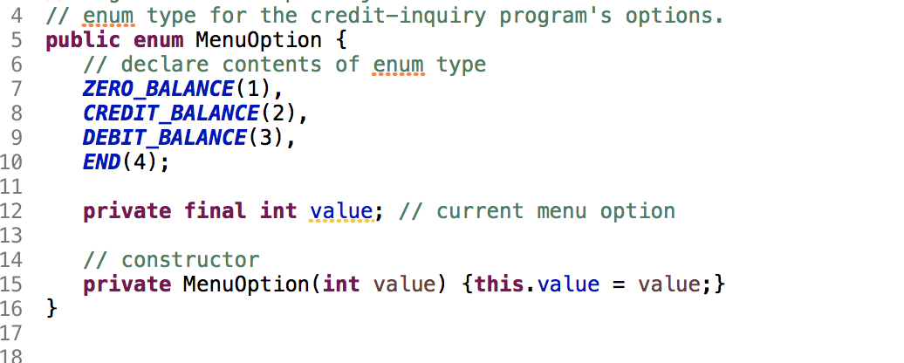
MenuOption enum

Slide 30
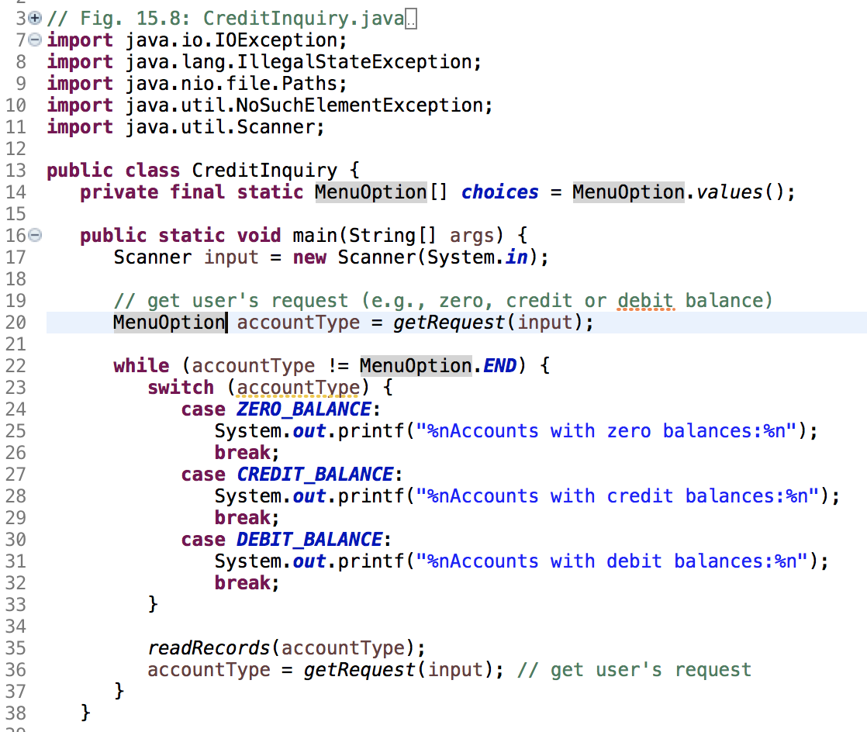

Slide 31
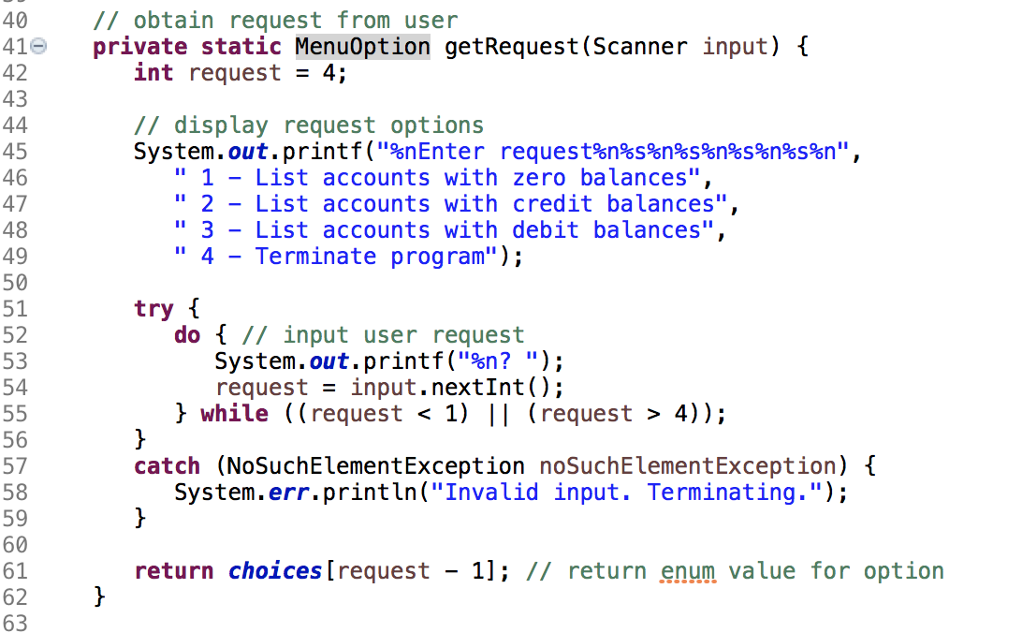

Slide 32
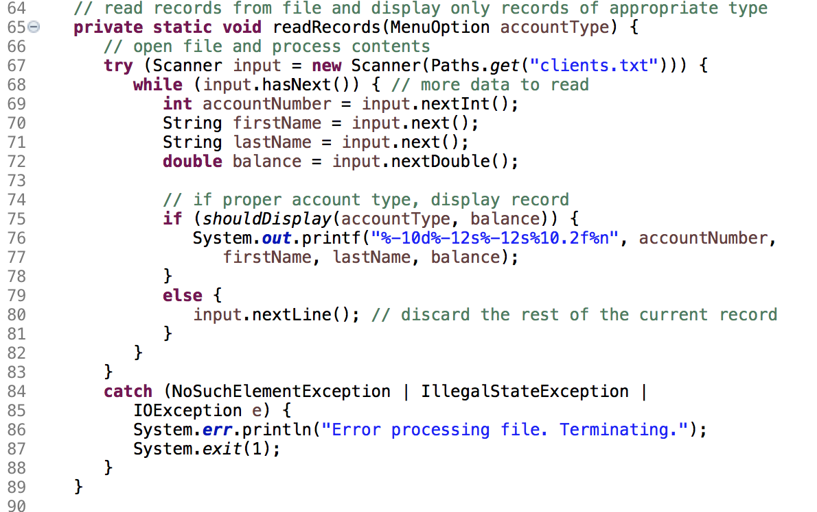

Slide 33
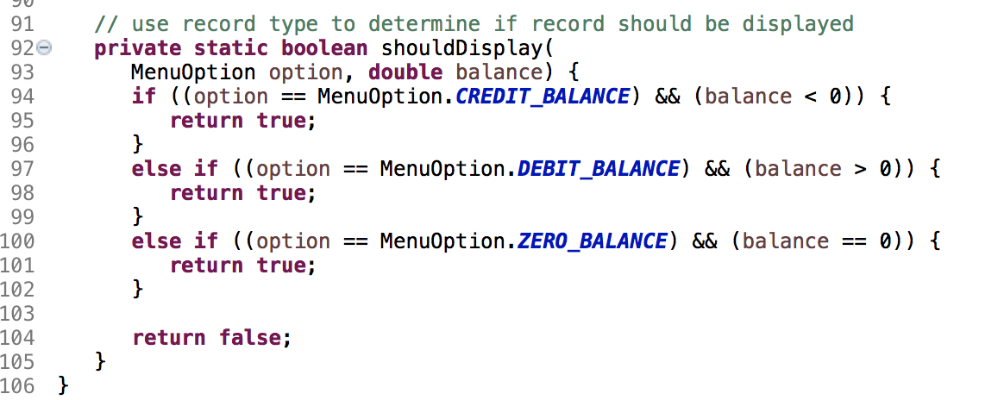

Slide 34
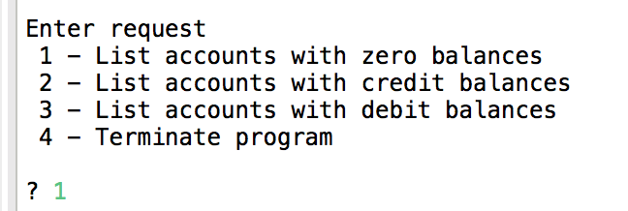

Slide 35
15.4.4 Updating Sequential-Access Files
The data in many sequential files cannot be modified without the risk of destroying other data in the file.
Rewriting the entire file is uneconomical to update just one record, but reasonable if a substantial number of records need to be updated.

Slide 36
15.5 XML Serialization
Sometimes we want to write an entire object to or read an entire object from a file or as you’ll see in the online REST Web Services chapter over a network connection.
XML (eXtensible Markup Language) is a widely used language for describing data. The APIs for manipulating objects as XML are built into Java SE

Slide 37
15.5 XML Serialization
In this section, we’ll manipulate objects using JAXB (Java Architecture for XML Binding).

Slide 38
15.5.1 Creating a Sequential File Using XML Serialization
JAXB works with POJOs (plain old Java objects)— no special superclasses or interfaces are required for XML-serialization support.
By default, JAXB serializes only an object’s public instance variables and public read–write properties.
a read–write property is defined by creating get and set methods with specific naming conventions.

Slide 39
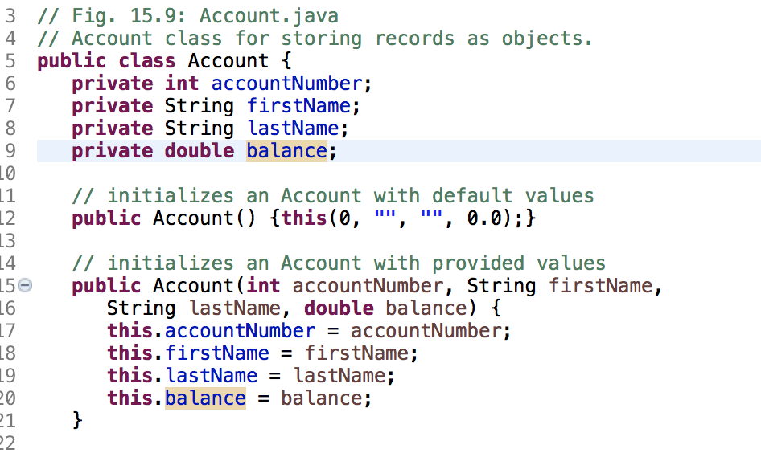

Slide 40
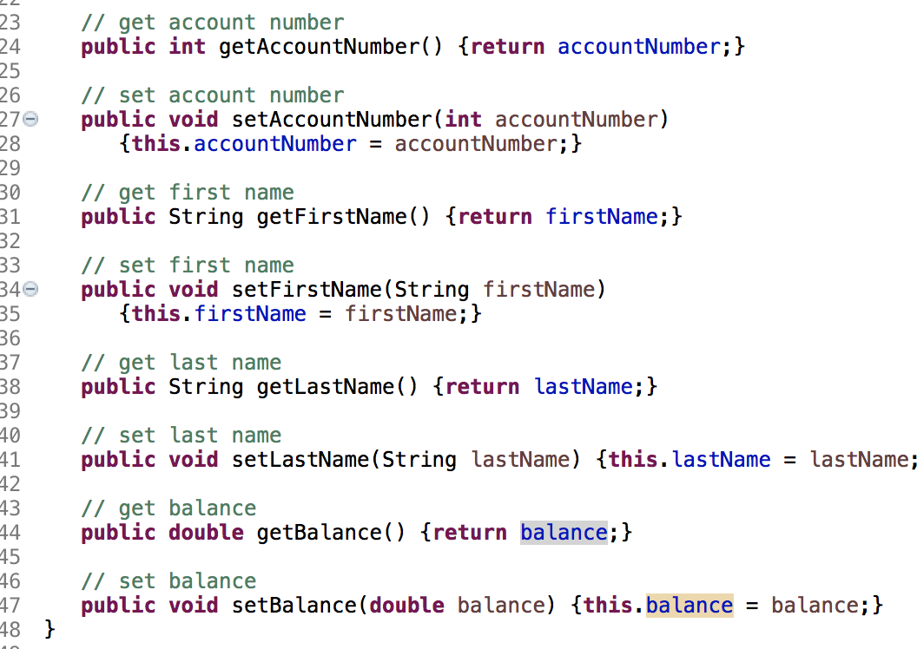

Slide 41
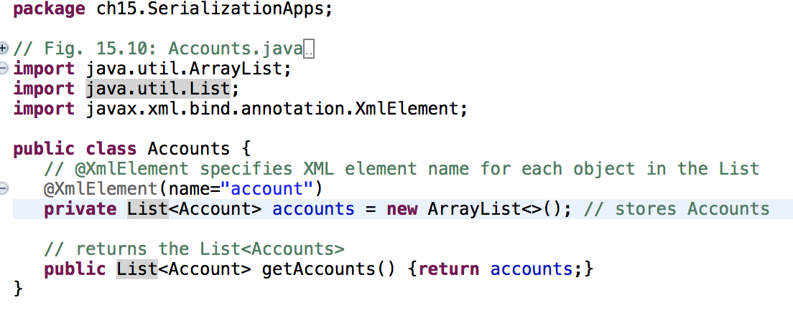

Slide 42
15.5.1 Creating a Sequential File Using XML Serialization(cont.)
@XmlElement(name="account")
The annotation @XMLElement indicates that the private instance variable should be serialized.
The annotation is required because the instance variable is not public and there’s no corresponding public read– write property.
name=“account” used to represent each of the List’s Account objects in the serialized output.

Slide 43
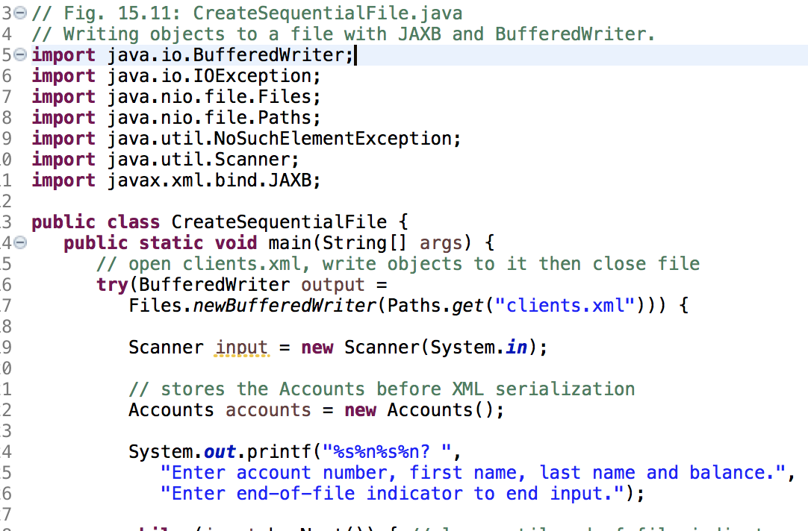

Slide 44
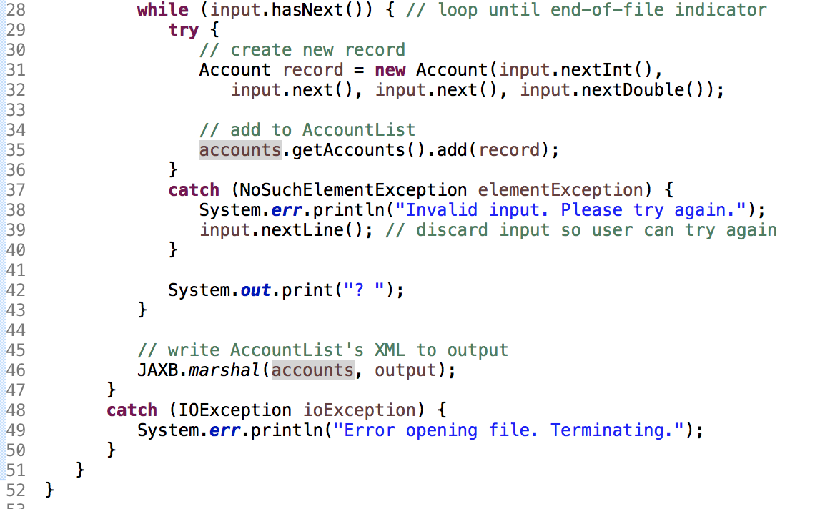

Slide 45
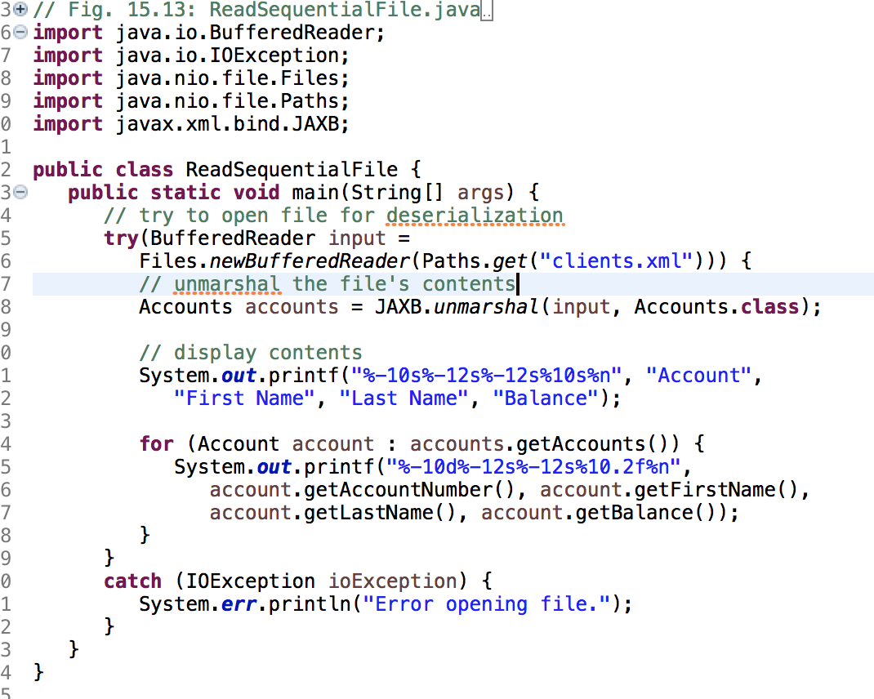

Slide 46
15.6 FileChooser and DirectoryChooser Dialogs
JavaFX classes FileChooser and DirectoryChooser (package javafx.stage) display dialogs that enable the user to select a file or directory, respectively.

Slide 47
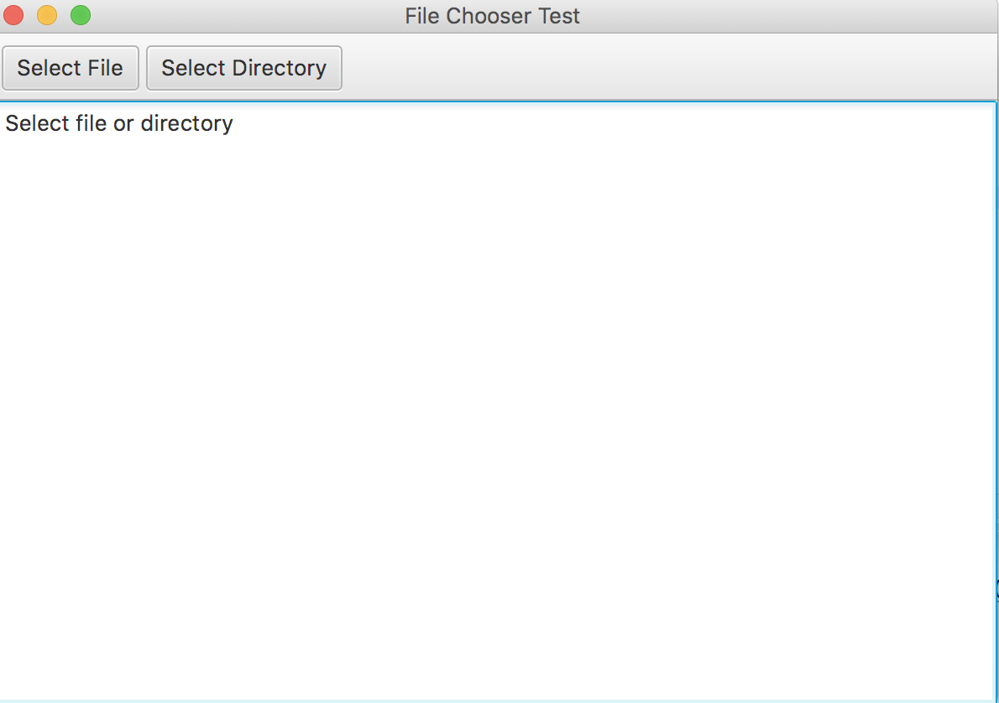
15.6 FileChooser and DirectorChooser Dialogs (cont.)

Slide 48
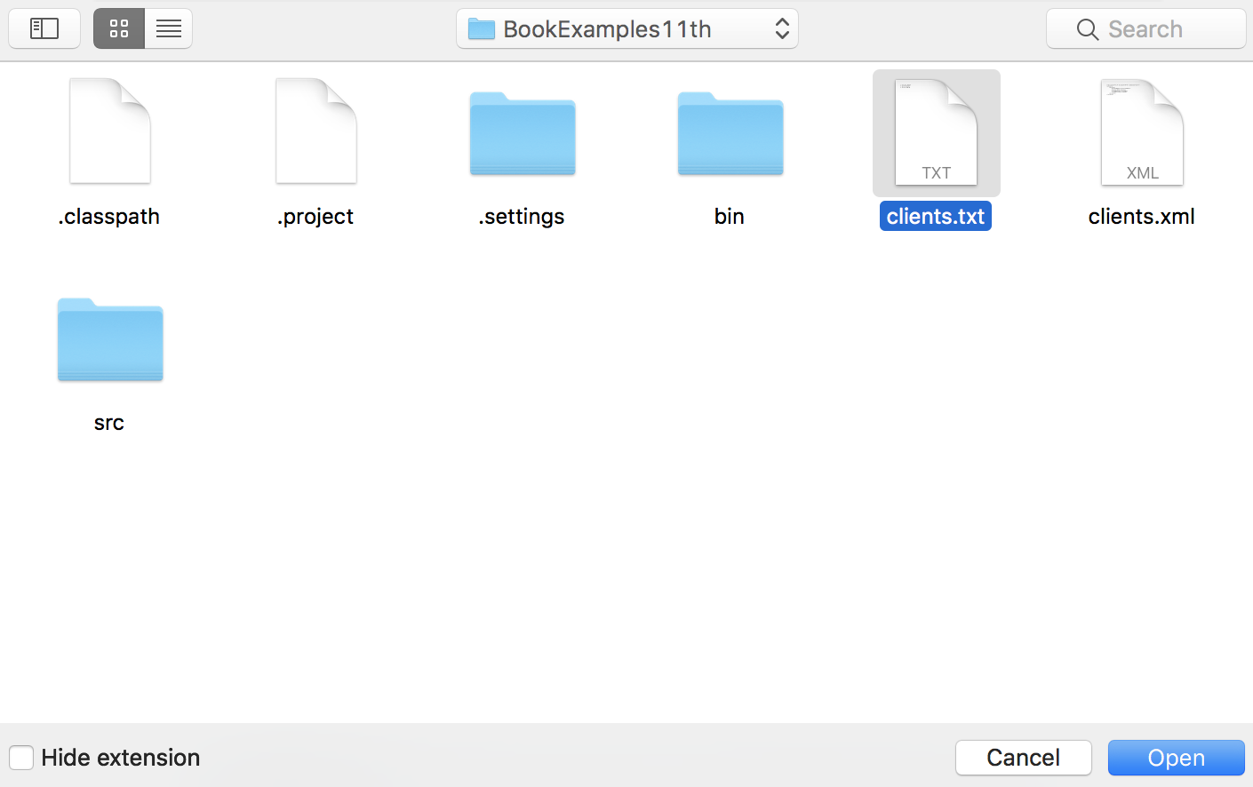
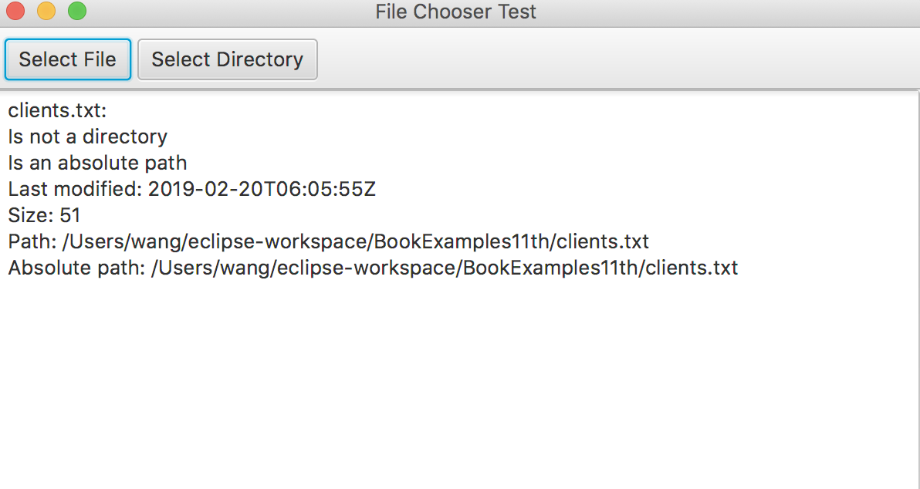

Slide 49
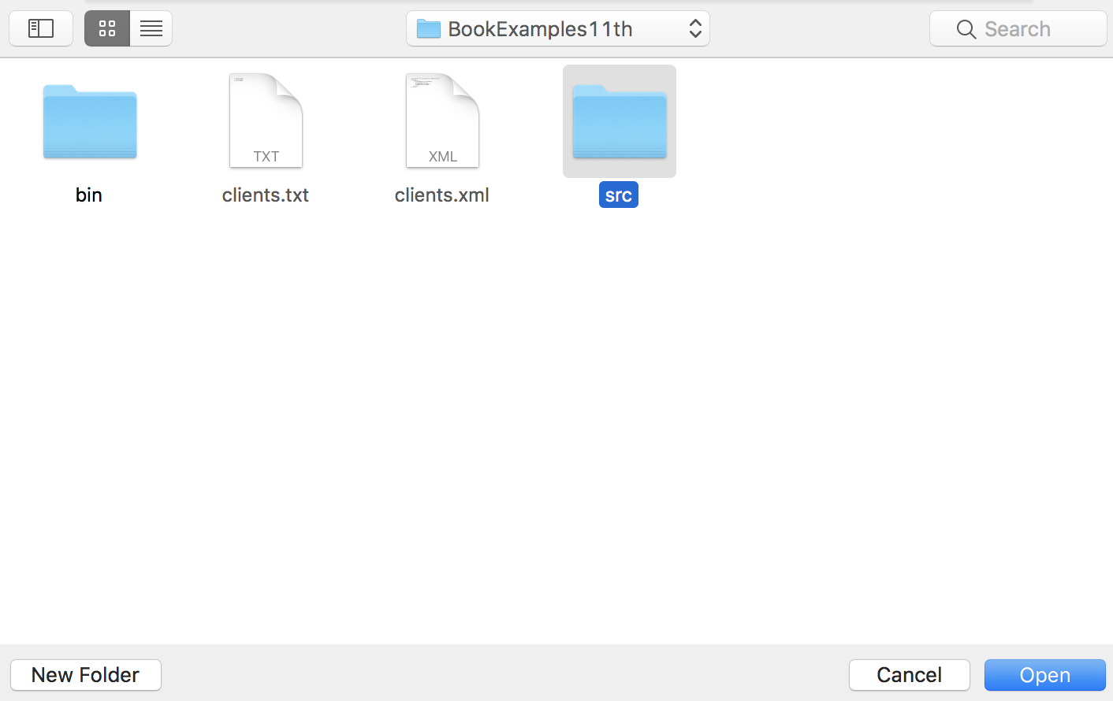
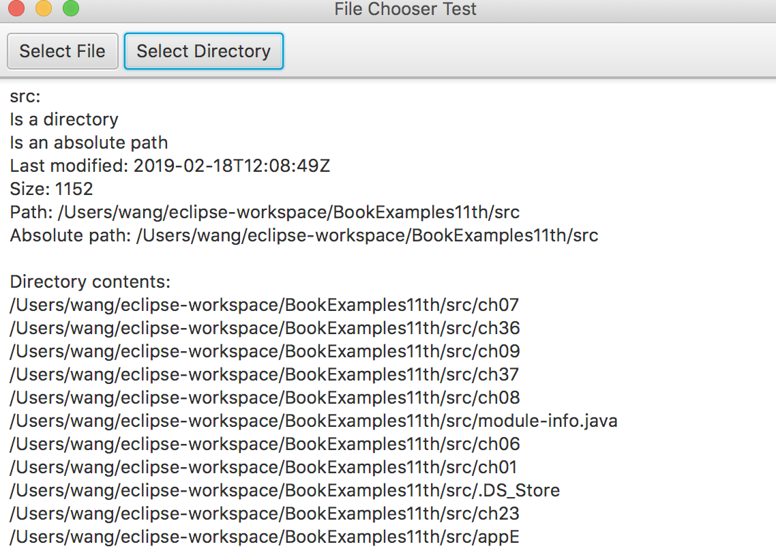

Slide 50
15.6 FileChooser and DirectorChooser Dialogs (cont.)
Creating the JavaFX GUI
BorderPane
600* 400
fx:id borderPane:
In the BorderPane’s top, we placed a ToolBar
In the BorderPane’s center, we placed a TextArea control with the fx:id textArea.

Slide 51
15.6 FileChooser and DirectorChooser Dialogs (cont.)
Drag other controls onto the ToolBar.
For the first Button, we set:
the Text property to "Select File",
the fx:id property to selectFileButton and
the On Action event handler to selectFileButtonPressed.
For the second Button, we set:
the Text property to "Select Directory",
the fx:id property to selectDirectoryButton and
the On Action event handler to selectDirectoryButtonPressed.

Slide 52
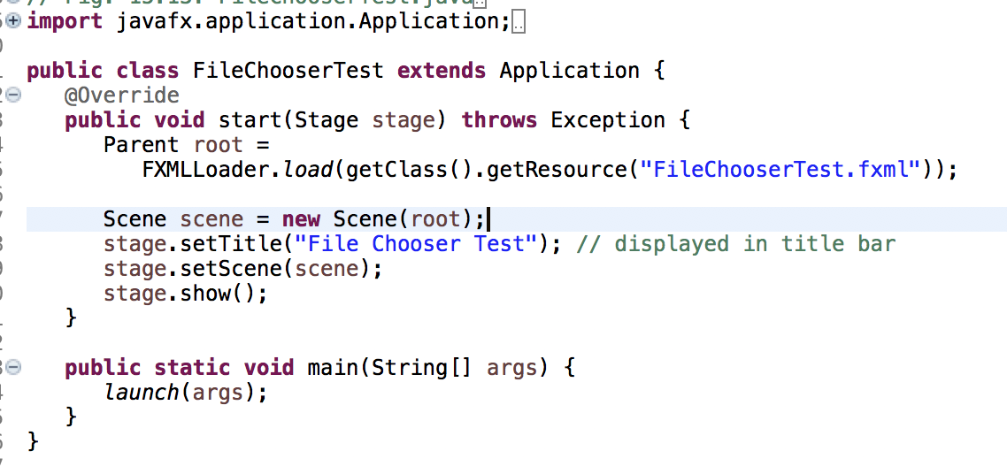

Slide 53
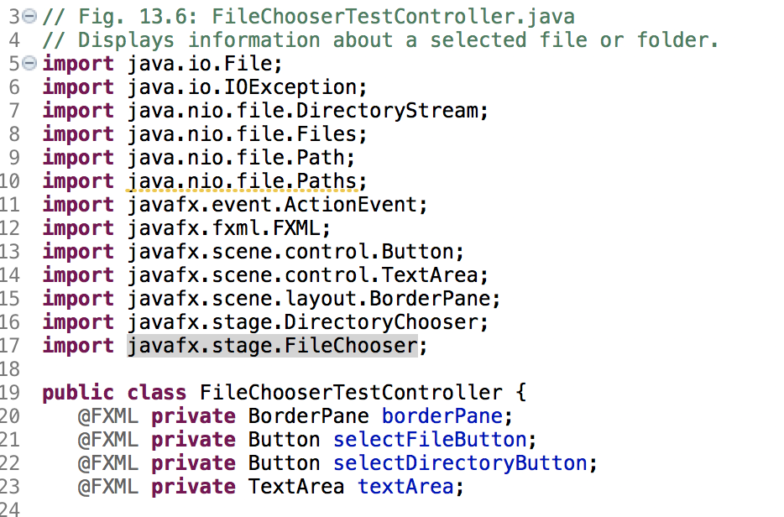

Slide 54
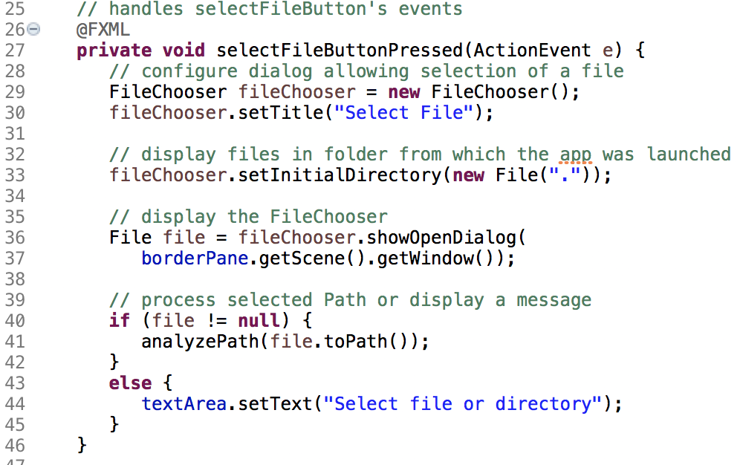

Slide 55
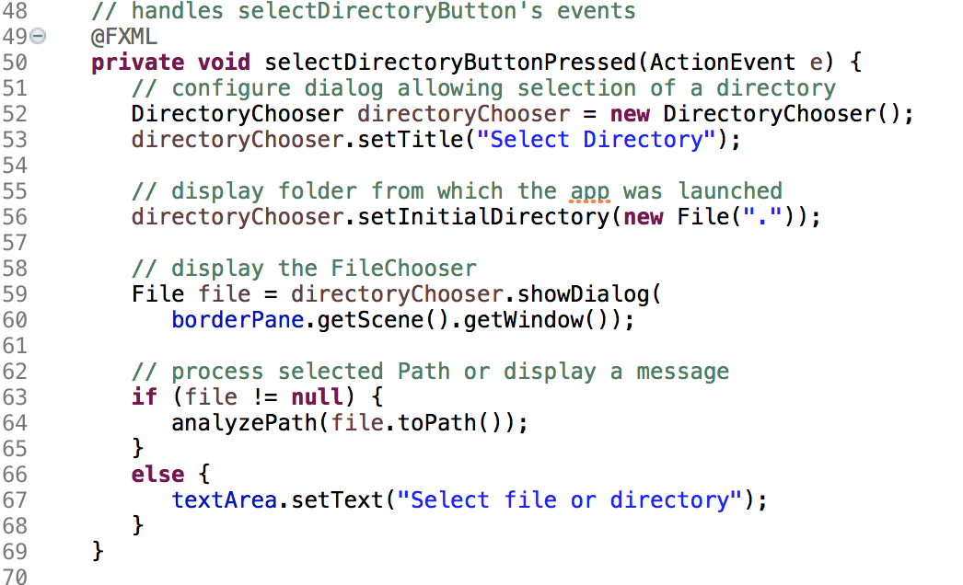

Slide 56
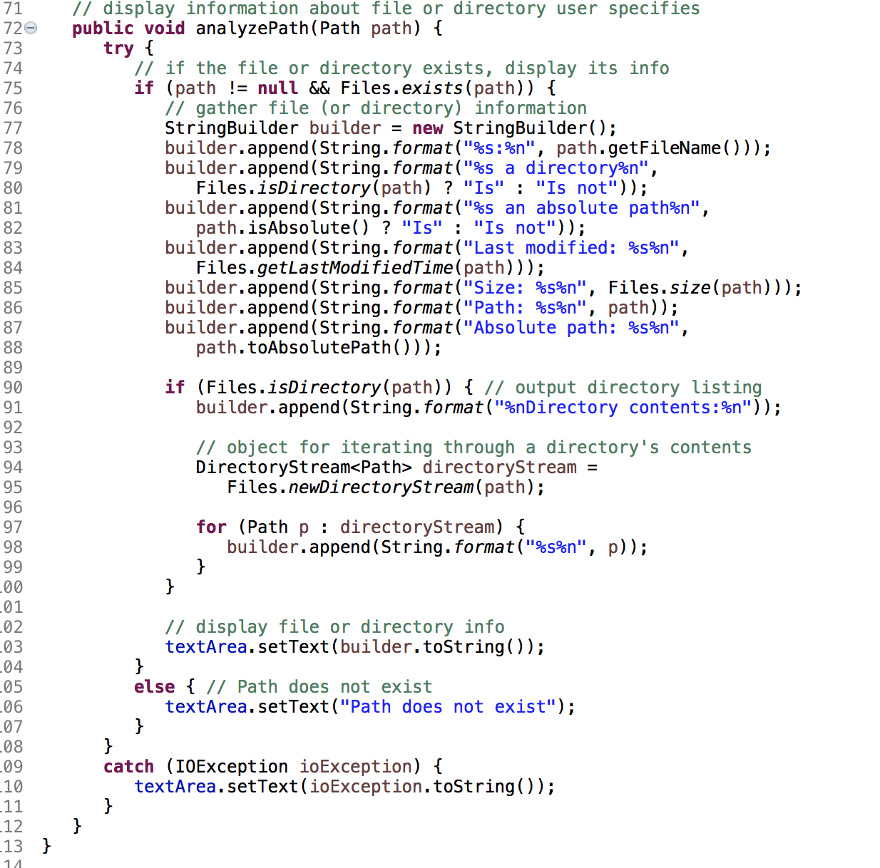
https://docs.oracle.com/javase/8/javafx/api/javafx/stage/FileChooser.html

Slide 57
15.7 Additional java.io Classes
This section overviews additional interfaces and classes (from package java.io) for byte-based input and output streams and character-based input and output streams.

Slide 59
15.7.1 Interfaces and Classes for Byte-Based Input and Output
InputStream and OutputStream classes
abstract classes that declare methods for performing byte-based input and output
InputStream Method Summary
int available()
Returns the number of bytes that can be read
void close()
void mark(int readlimit)
Marks the current position in this input stream.
boolean markSupported()

Slide 60
15.7.1 Interfaces and Classes for Byte-Based Input and Output (cont.)
abstract int read()
Reads the next byte of
int read(byte[] b)
int read(byte[] b, int off, int len)
void reset()
Repositions this stream to the position at the time the mark method was last called on this input stream.
long skip(long n)
Skips over and discards n bytes of data from this input stream.

Slide 61
15.7.1 Interfaces and Classes for Byte-Based Input and Output (cont.)
OutputStream Method Summary
void close()
Closes this output stream and releases any system resources associated with this stream.
void flush()
Flushes this output stream and forces any buffered output bytes to be written out.
void write(byte[] b) Writes b.length bytes from the specified byte array to this output stream.
void write(byte[] b, int off, int len)
Writes len bytes from the specified byte array starting at offset off to this output stream.
abstract void write(int b)
Writes the specified byte to this output stream.

Slide 62
15.7.1 Interfaces and Classes for Byte-Based Input and Output (cont.)
PipedInputStream and PipedOutputStream classes
Establish pipes between two threads in a program
Pipes are synchronized communication channels between threads
FilterInputStream and FilterOutputStream classes
Provides additional functionality to stream, such as aggregating data byte into meaningful primitive-type units

Slide 63
15.7.1 Interfaces and Classes for Byte-Based Input and Output (cont.)
PrintStream class
Performs text output to a specified stream
Support the print() and println() methods for all types, including Object.
DataInput and DataOutput interfaces
For reading and writing primitive types to a file
DataInput implemented by classes RandomAccessFile and DataInputStream, DataOutput implemented by RandomAccessFile and DataOuputStream
SequenceInputStream class enables concatenation of several InputStreams – program sees group as one continuous InputStream
Examples: SequenceInputStreamDemo.java RandomAccessFileDeom

Slide 64
15.7.1 Interfaces and Classes for Byte-Based Input and Output (cont.)
Buffering is an I/O-performance-enhancement technique
Greatly increases efficiency of an application
Output (uses BufferedOutputStream class)
Each output statement does not necessarily result in an actual physical transfer of data to the output device – data is directed to a region of memory called a buffer (faster than writing to file)
When buffer is full, actual transfer to output device is performed in one large physical output operation (also called logical output operations)
Partially filled buffer can be forced out with method flush

Slide 65
15.7.1 Interfaces and Classes for Byte-Based Input and Output (cont.)
Input (uses BufferedInputStream class)
Many logical chunks of data from a file are read as one physical input operation (also called logical input operation)
When buffer is empty, next physical input operation is performed
ByteArrayInputStream and ByteArrayOutputStream classes used for inputting from byte arrays in memory and outputting to byte arrays in memory

Slide 66
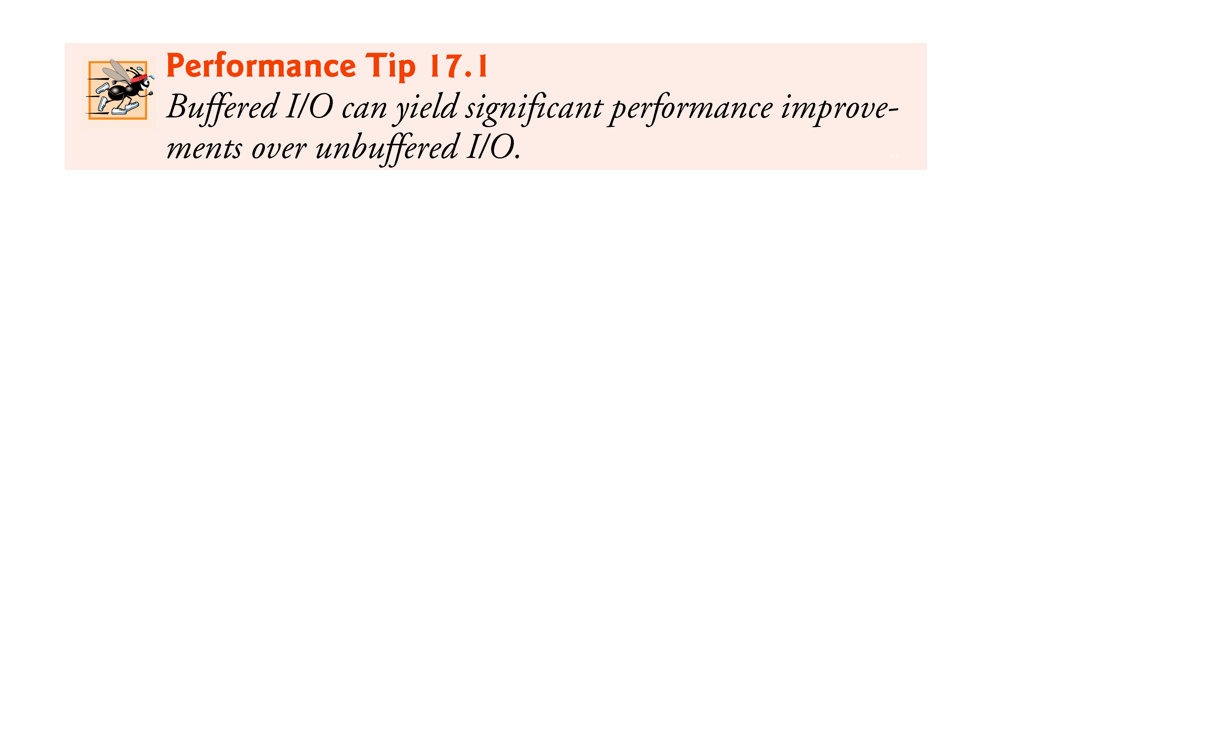

Slide 67
15.7.2 Interfaces and Classes for Character-Based Input and Output
Reader and Writer abstract classes
Unicode two-byte, character-based streams
FileReader and FileWriter classes
Can use to read/write the contens of a file.
BufferedReader and BufferedWriter classes
Enable buffering for character-based streams
CharArrayReader and CharArrayWriter classes
Read and write streams of characters to character arrays
LineNumberReader class
Buffered character stream that keeps track of number of lines read
PipedReader and PipedWriter classes
Implement piped-character streams that can be used to transfer information between threads
StringReader and StringWriter classes
Read characters from and write characters to Strings

Slide 68
ZIP Archives
ZIP archives store one or more files in (usually) compressed format.
Each ZIP archive has a header with information such as the name of the file and the compression method that was used.

Slide 69
a typical code sequence to read through a ZIP file

Slide 70
to read a text file inside a ZIP file, you can use the following loop:

Slide 71
a typical code sequence to place entry into the ZIP file

Slide 72

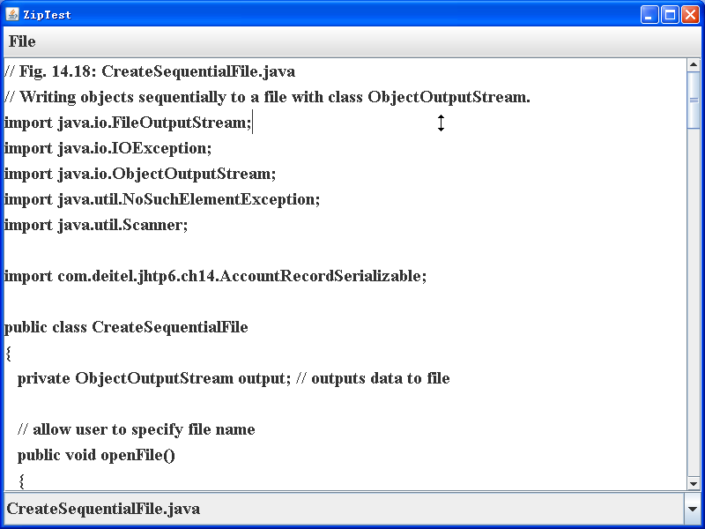
Two examples:
ZipCompress.java
Create a zip file and then input an entry in it.
ZipTest.java
See also:http://www.trustice.com/java/tar/
Rar file : http://orz.javaeye.com/blog/110479

Slide 73
Save image in the file(.jpg)
JPEGImageEncoder
Encodes buffers of image data into JPEG data streams.
Required to provide image data in a Raster or a BufferedImage
JPEGImageDecoder
This interface describes a JPEG data stream decoder.
Takes an InputStream that contains JPEG encoded image data.
Returned in either a Raster or a BufferedImage.

Slide 74
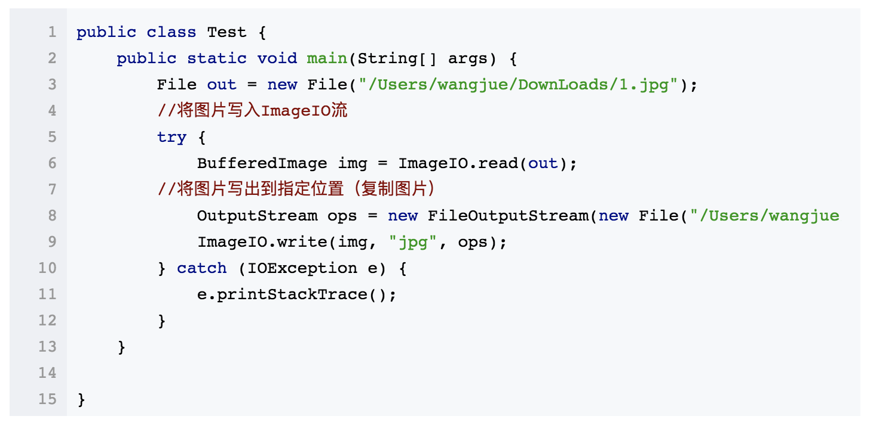

Slide 75
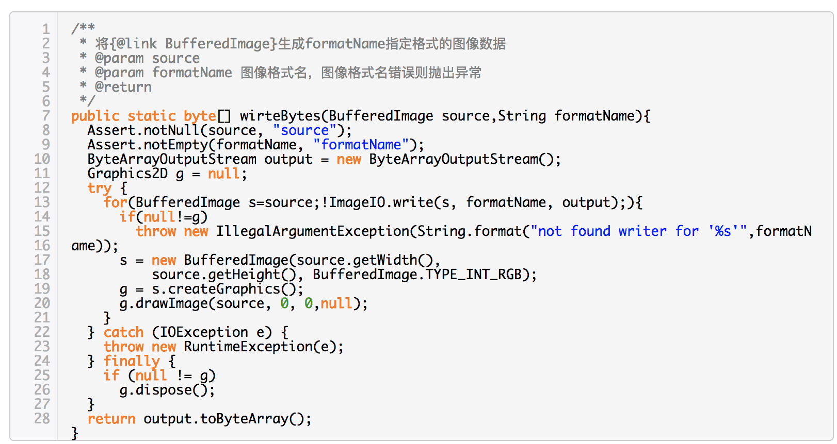

Slide 76
Write and receive data (.xls)
JXL:
Download Xls.jar: http://www.andykhan.com/jexcelapi/
Examples: ExcelTest.java
POI:
EXAMPLEs: https://www.cnblogs.com/SimonHu1993/p/8202391.html

Slide 77
An other Class: Runtime
Every Java application has a single instance of class Runtime that allows the application to interface with the environment in which the application is running.
Process exec(String command)
Executes the specified string command in a separate process.
Exec1.java
Exec2.java

Slide 78
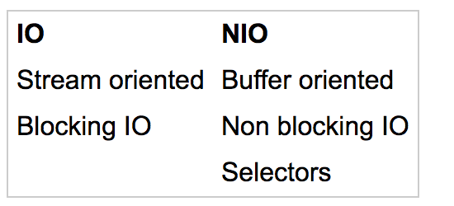
Main Differences Between Java NIO and IO

Slide 79
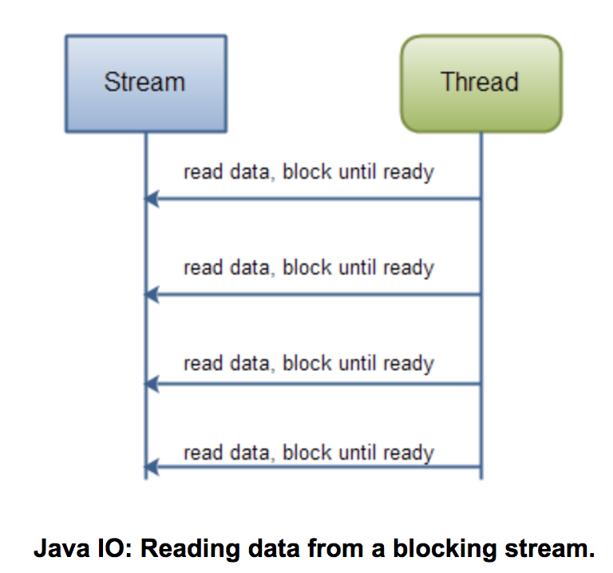
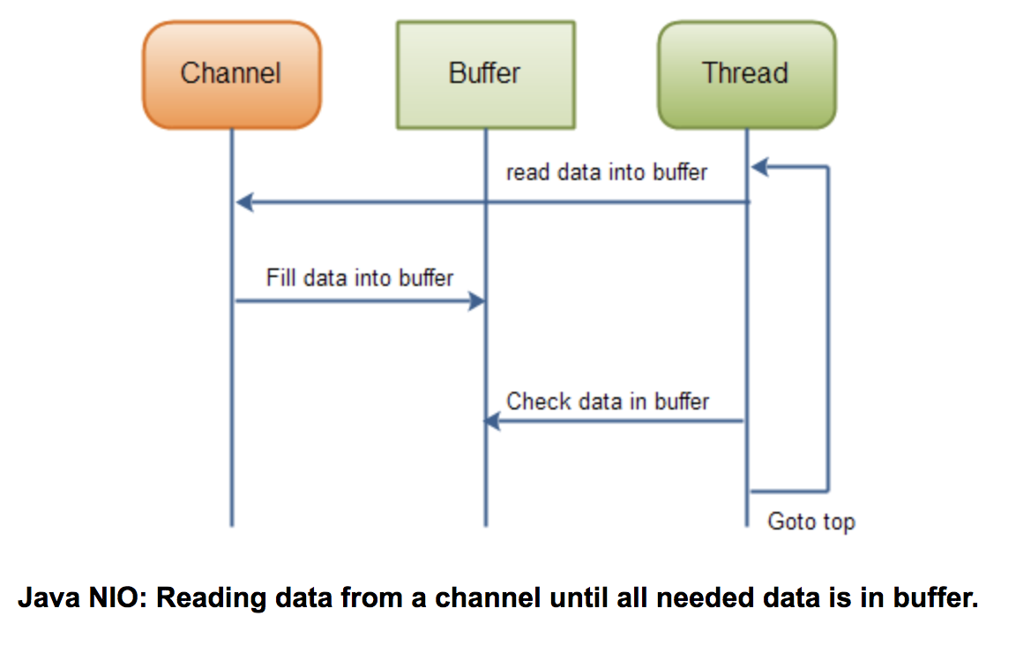
http://ifeve.com/overview/

